Slide 1

Introduction to the data build tool (dbt)
John Miner Data Architect
john.miner@insight.com

Slide 2
Agenda
01 | Background
02 | Configure VS Code
03 | Materializing data
04 | Data Quality
05 | Producing Documentation

Slide 3
Background
Concept
Data build tool (dbt) is an open-source tool that helps engineers transform existing data within their warehouses.
VS Code Integration
The framework is written in Python with the translations defined as SQL scripts and/or YAML files.
Target Platforms
The real power comes from the fact that adapters have been written for many different target database management systems.

Slide 4



Configure VS Code
Requirements:
Install Python language version 3.7 or above.
Pip install dbt-core.
Pip install dbt-(adapter).
Local ODBC driver for (adapter).

Slide 5
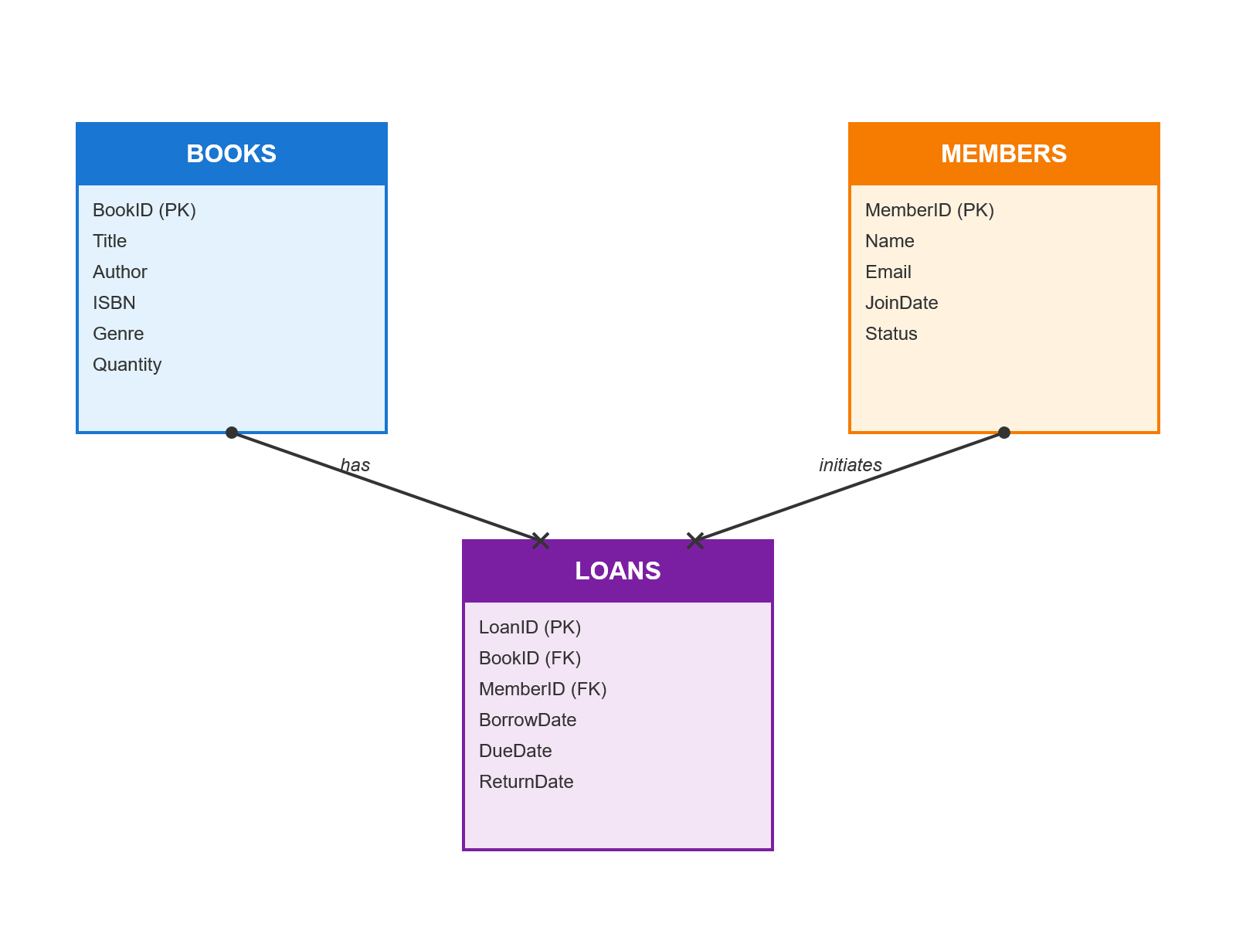
Library Schema
AI generated tables
CSV sample records

Slide 6



Source + Target
Azure SQL Database
Initialize dbt project
How to seed tables

Slide 7
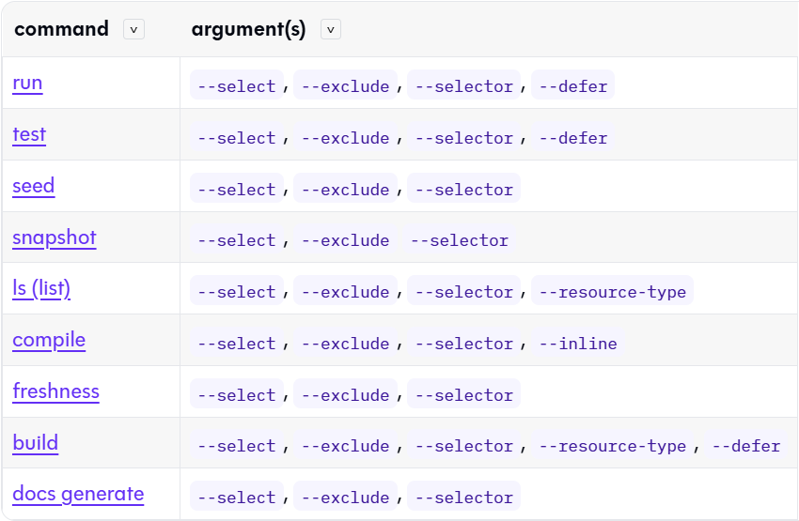
Command Line
Run commands from a terminal window.

Slide 8
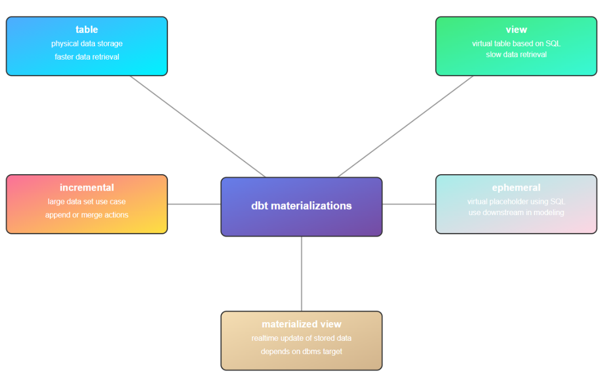
Materializing Data
Tables
Views
Incremental
Ephemeral
Materialized Views (Not Supported)
Snapshots (SCD Type2)

Slide 9
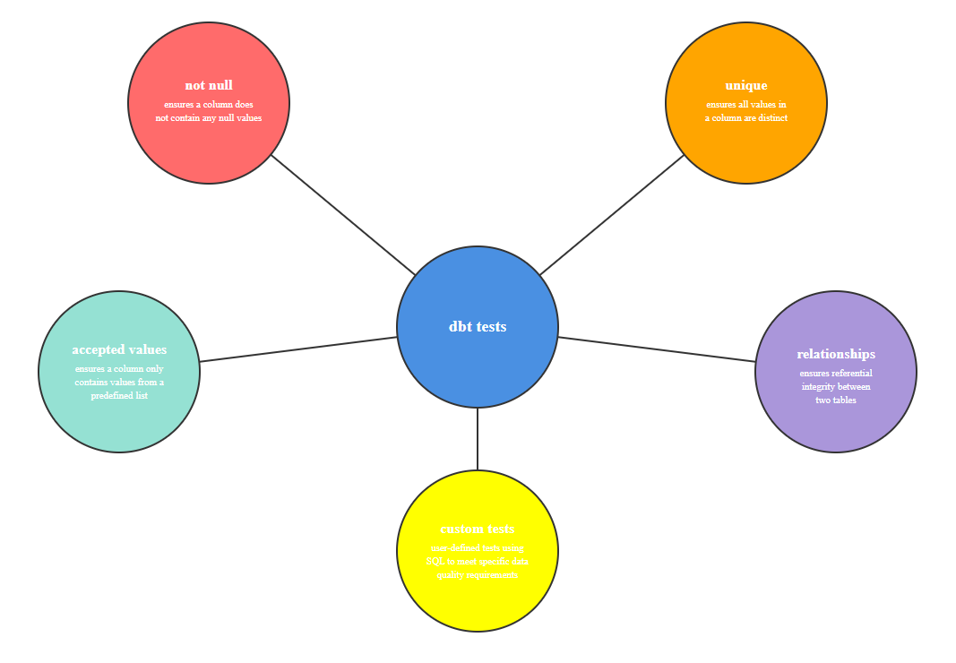
Testing Data
Not Null
Unique
Accepted Values
Relationships
Custom

Slide 10
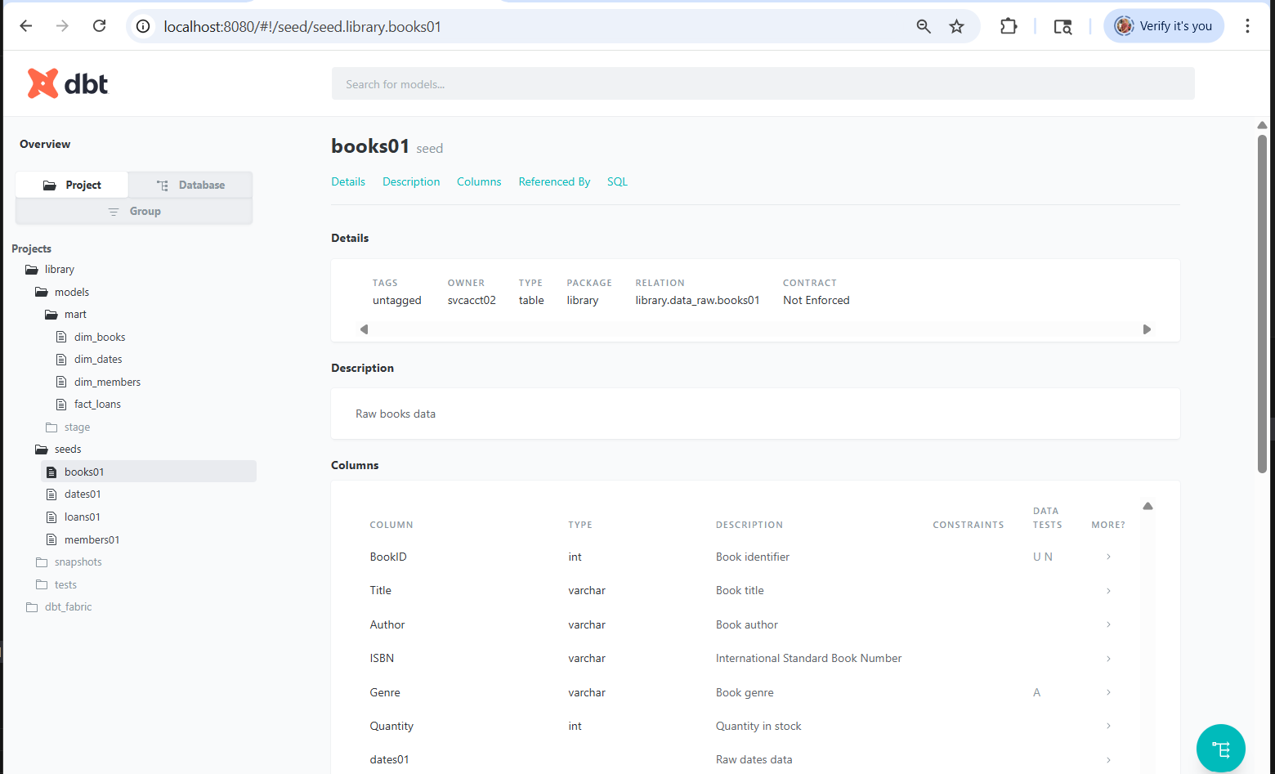
Generate Documentation
dbt docs generate
dbt docs serve

Slide 11
Summary
The Data build tool (dbt) depends upon the data being already loaded into raw tables within the database and/or warehouse.
Power users who can write SQL and YAML can be very productive on building out models. There are several different ways to materialize the data as well as test for data quality.
The whole project is part of a directed acyclic graph. Therefore, unique file names are important. Additional information in property files allow for documentation to be produced.
In short, the dbt tool makes it easy to build out data models.

Slide 12
References
Chinook Sample Project
https://tinyurl.com/yc6p7ex9
dbt Labs – SQL Server Adapter
https://tinyurl.com/55ez63n2
Microsoft Fabric - Warehouse Adapter
https://tinyurl.com/538ynnf6
Microsoft Fabric - dbt jobs
https://tinyurl.com/yy2k8chn

